Slide 1

Course Work
COMP 1047
Youyao Gao 20516639

Slide 2
Contents
Cache Architecture
Pipeline Architecture
Instruction Set Architecture (ISA)
PowerPC
ARM
x86

Slide 3
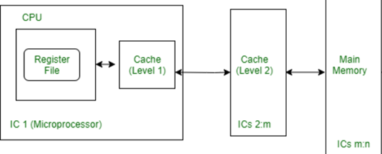
Cache Architecture
Cache architecture refers to the design and implementation of cache memory, which is a small, fast type of volatile computer memory that provides high-speed data access to a processor and stores frequently used computer programs, applications, and data.
In the big picture of computer architecture, the cache sits between the CPU and the computer's main memory (RAM) in the memory hierarchy.
(Patterson & Hennessy, 2013)

Slide 4
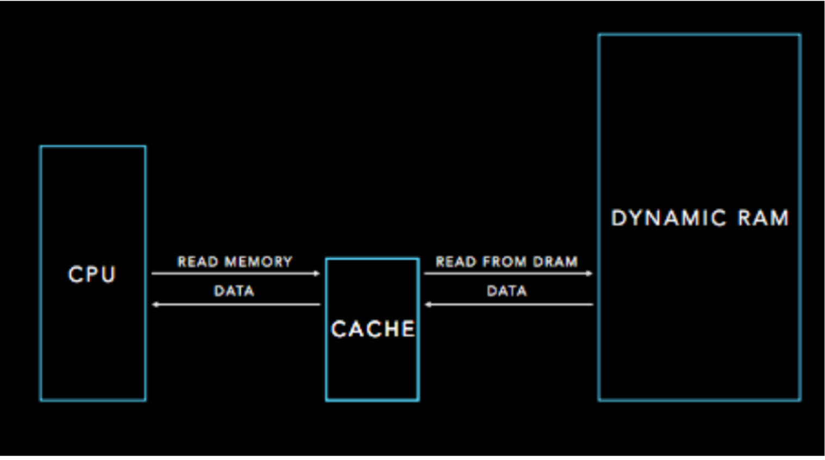
Cache Architecture
Efficient cache design and management are crucial for reducing the wait time of the Arithmetic Logic Unit (ALU) and improving the overall performance of the CPU.
(Patterson & Hennessy, 2013)

Slide 5
Pipeline Architecture
Pipeline architecture in computing refers to a technique used to improve the throughput of a processor by dividing the processing of instructions into multiple stages.
In the grand scheme of computer architecture, pipelining fits within the processing unit's design, contributing to how quickly and efficiently a CPU can execute a sequence of instructions.
It can promote the performance of the CPU which is related to the COMP1047-W1b-Performance.
(Patterson & Hennessy, 2013)

Slide 6
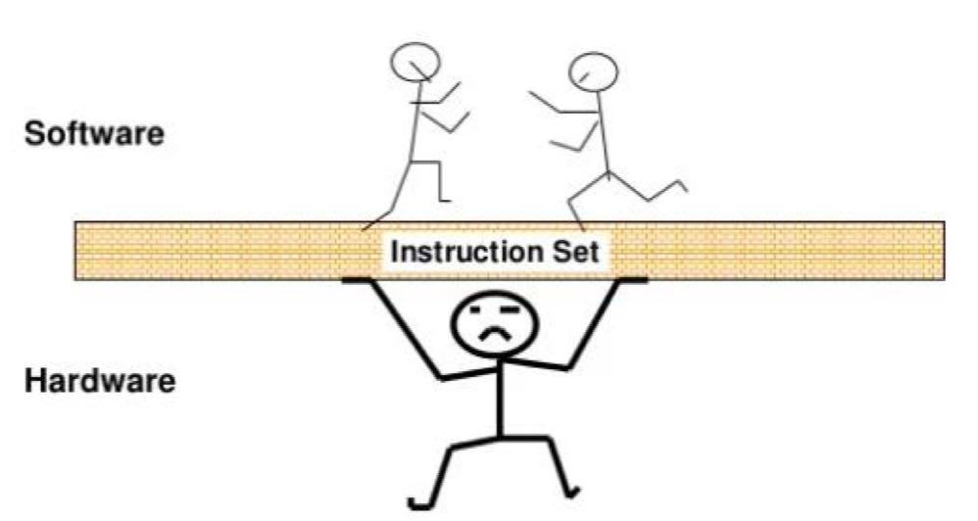
Instruction Set Architecture (ISA)
ISA is a key part of computer architecture that defines the set of instructions a computer's processor can execute. It serves as the interface between software and hardware, providing a framework for the execution of programs by the CPU.
The ISA acts as a bridge between the software that runs on a computer and the hardware that executes it. It's a fundamental aspect that defines the capabilities and performance characteristics of computing systems, affecting everything from the micro-architecture to the overall system architecture.
COMP1047-W1a-Introductuion page 20
(Patterson & Hennessy, 2013)

Slide 7
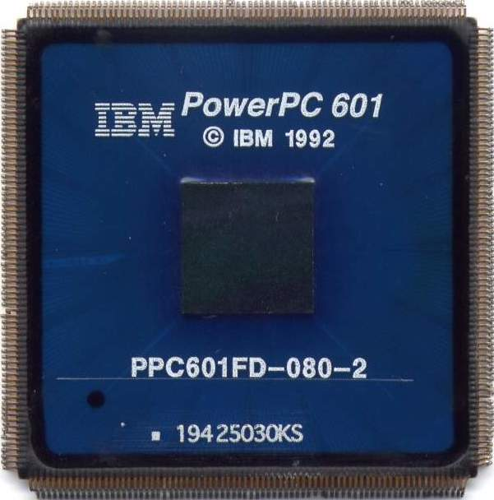
PowerPC
PowerPC (Performance Optimization With Enhanced RISC – Performance Computing) is a type of RISC (Reduced Instruction Set Computing) architecture that was developed by the AIM alliance, which stands for Apple, IBM, and Motorola. It was designed in the early 1990s as a part of the collaborative effort to develop a new, advanced computing architecture.
(Hackaday, 2022)
(Power Progress Community, 2022)
（https://www.google.com.hk/url?sa=i&url=https%3A%2F%2Fen.wikipedia.org%2Fwiki%2FPowerPC&psig=AOvVaw2URh9x9-cabGT8WmlWYhtS&ust=1711372846823000&source=images&cd=vfe&opi=89978449&ved=0CBIQjRxqFwoTCICV3-b-jIUDFQAAAAAdAAAAABAE）

Slide 8
ARM
ARM, originally standing for Acorn RISC Machine, and later Advanced RISC Machine, is a family of reduced instruction set computing (RISC) architectures for computer processors. ARM architecture is known for its power efficiency and minimalistic instruction set.
(Patterson & Hennessy, 2013)

Slide 9
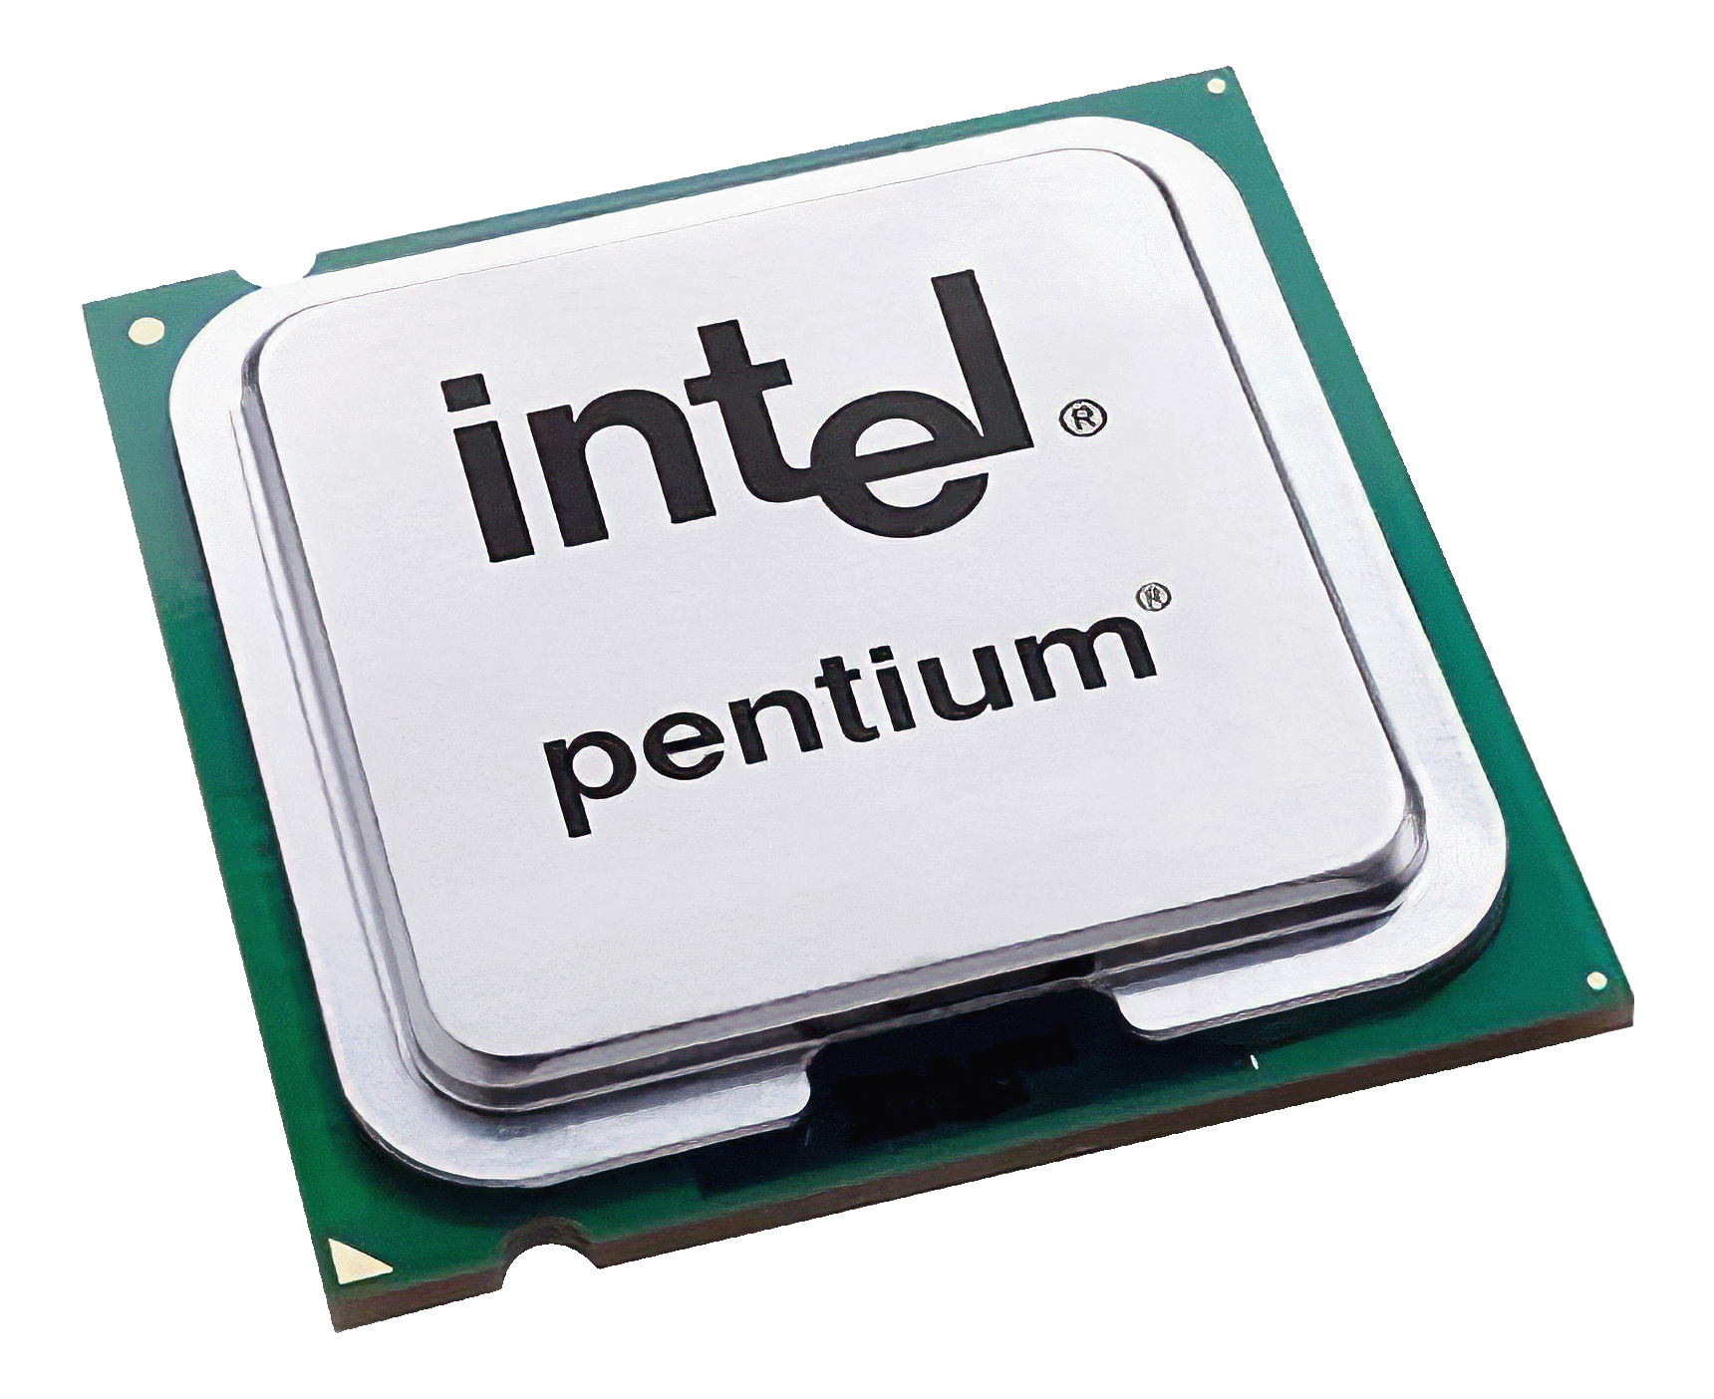
x86
x86 refers to a family of instruction set architectures (ISAs) based on the Intel 8086 microprocessor and its 8088 variant. It is one of the most widely used architectures in personal computing and has a significant legacy in the computer industry.
(Child, 2023)
（https://www.google.com.hk/url?sa=i&url=https%3A%2F%2Ftechterms.com%2Fdefinition%2Fx86&psig=AOvVaw0-Lfsr1n-9ndoASFviyR4f&ust=1711372989850000&source=images&cd=vfe&opi=89978449&ved=0CBAQjRxqFwoTCOifhq3_jIUDFQAAAAAdAAAAABAD）

Slide 10
X86 Operands
Registers: x86 CPUs have general-purpose registers (like AX, BX, CX, DX), segment registers, index and pointer registers, and special-purpose registers. Instructions can use these registers to perform operations.
Immediate Values: These are constant values encoded directly in the instructions.
Memory Addresses: Instructions can reference data in memory through direct addressing, indirect addressing, or using base and index with optional scaling and displacement.
(Patterson & Hennessy, 2013)

Slide 11
X86 Instructions
MOV: Transfers data from one location to another (e.g., MOV AX, BX copies the contents of BX into AX).
ADD/SUB: Arithmetic addition and subtraction (e.g., ADD AX, 10 adds 10 to the contents of AX).
MUL/DIV: Multiplication and division operations.
INC/DEC: Increment and decrement operations, respectively.
AND/OR/XOR/NOT: Logical operations on bits.
(Intel Corporation, 2021)

Slide 12
X86 Branching
JMP: Unconditional jump, changes the instruction pointer to a new location.
JE/JZ: Jump if equal/jump if zero, takes the jump if the last comparison resulted in equality/zero.
JNE/JNZ: Jump if not equal/jump if not zero, takes the jump if the last comparison was not equal/non-zero.
JG/JL: Jump if greater/jump if less, used for signed comparisons.
JGE/JLE: Jump if greater or equal/jump if less or equal, also used for signed comparisons.
JA/JB: Jump if above/jump if below, used for unsigned comparisons.
(Intel Corporation, 2021)

Slide 13
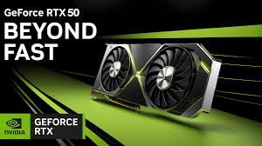
Latest Industry Development and Research Achievement of X86
Advanced Microarchitecture Designs
Support for Virtualization
Integrated Graphics and Processing Units (GPUs)
Adoption of AI and ML Optimizations
Transition to 5nm and 3nm Process Technologies
(https://www.google.com.hk/url?sa=i&url=https%3A%2F%2Fwccftech.com%2Fnvidia-geforce-rtx-50-flagship-gaming-gpu-gddr7-memory-384-bit-bus-rumor%2F&psig=AOvVaw2FdEJSHbBIdcMGmmO3A7vl&ust=1711373068498000&source=images&cd=vfe&opi=89978449&ved=0CBAQjRxqFwoTCNjY3tT_jIUDFQAAAAAdAAAAABAD)
(Wccftech, 2022)

Slide 14
Reference List
Child, J. (2023, January 5). AMD Claims First x86 Processor with Dedicated AI Hardware. All About Circuits. Retrieved from https://www.allaboutcircuits.com
Hackaday (2022). An Open Source PowerPC Notebook Edges Closer. Hackaday. Available at: https://hackaday.com
Intel Corporation. (2021). Intel 64 and IA-32 Architectures Software Developer’s Manual. [online] Available at: https://www.intel.com/content/www/us/en/developer/articles/technical/intel-sdm.html [23 March].
Patterson, D. A., & Hennessy, J. L. (2013). Computer Organization and Design: The Hardware/Software Interface (5th ed.). Morgan Kaufmann.
Power Progress Community (2022). Introducing “Django”, a cheap and compact PowerPC motherboard project. Power Progress Community. Available at: https://www.powerprogress.org/en/
Wccftech. (2022). AMD Achieves Record x86 CPU Market Share In Q1 2022: Desktop & Notebook Segment Recovers, Server Share Now at 11.6%. Retrieved from https:// wccftech.com

Slide 15


